Slide 1
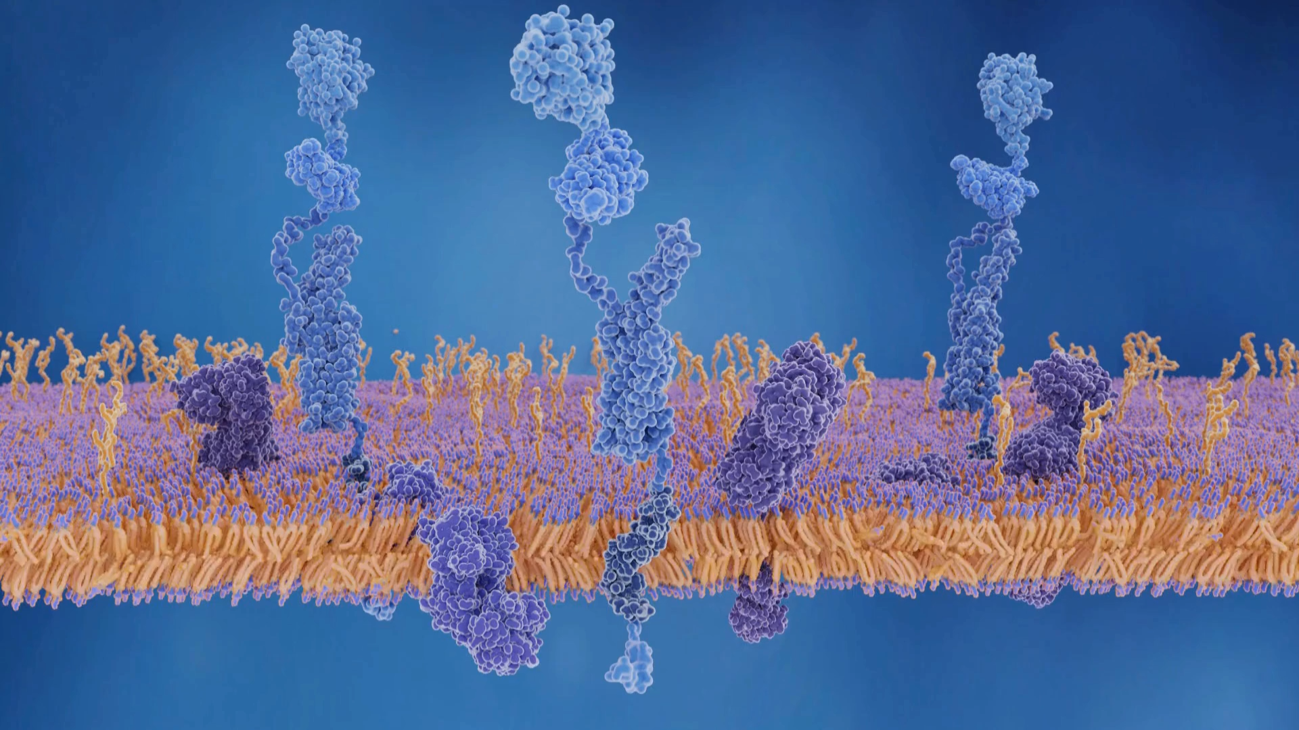


Curious Case
Of
Mrs. A
(anonymized)
By Dr Varun Tyagi

Slide 2
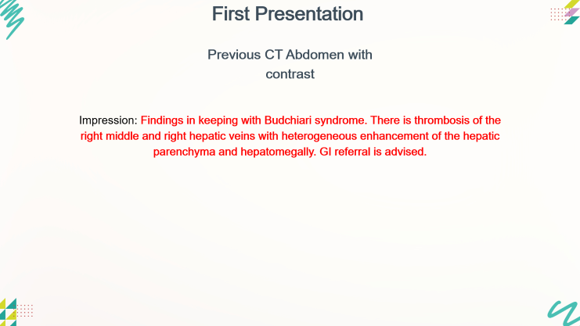
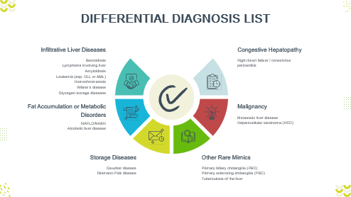
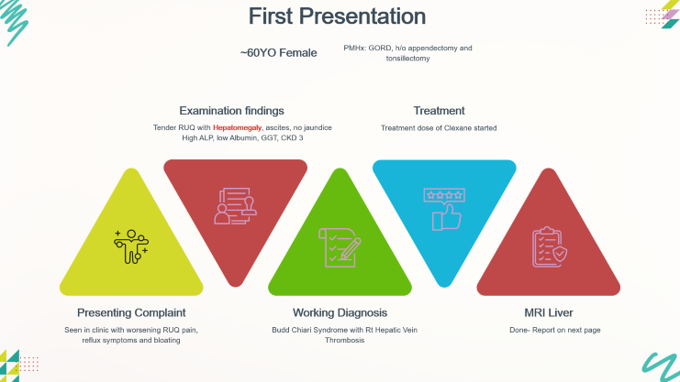


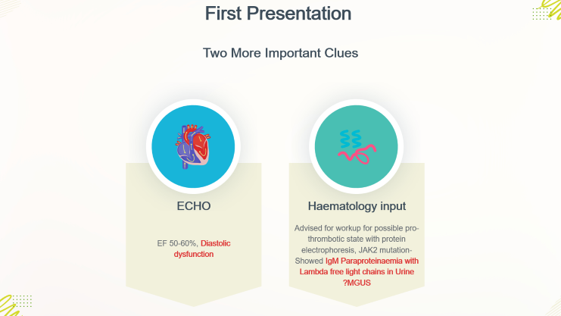
First Presentation

Slide 3











First Presentation
~60YO Female
PMHx: GORD, h/o appendectomy and tonsillectomy
Examination findings
Treatment
Tender RUQ with Hepatomegaly, ascites, no jaundice
High ALP, low Albumin, GGT, CKD 3
Treatment dose of Clexane started
Presenting Complaint
Working Diagnosis
MRI Liver
Seen in clinic with worsening RUQ pain, reflux symptoms and bloating
Budd Chiari Syndrome with Rt Hepatic Vein Thrombosis
Done- Report on next page

Slide 4
First Presentation
Previous CT Abdomen with contrast
Impression: Findings in keeping with Budchiari syndrome. There is thrombosis of the right middle and right hepatic veins with heterogeneous enhancement of the hepatic parenchyma and hepatomegally. GI referral is advised.

Slide 5
First Presentation
MRI Liver
Conclusion: Hepatomegaly, no evidence of Budd Chiari Syndrome

Slide 6







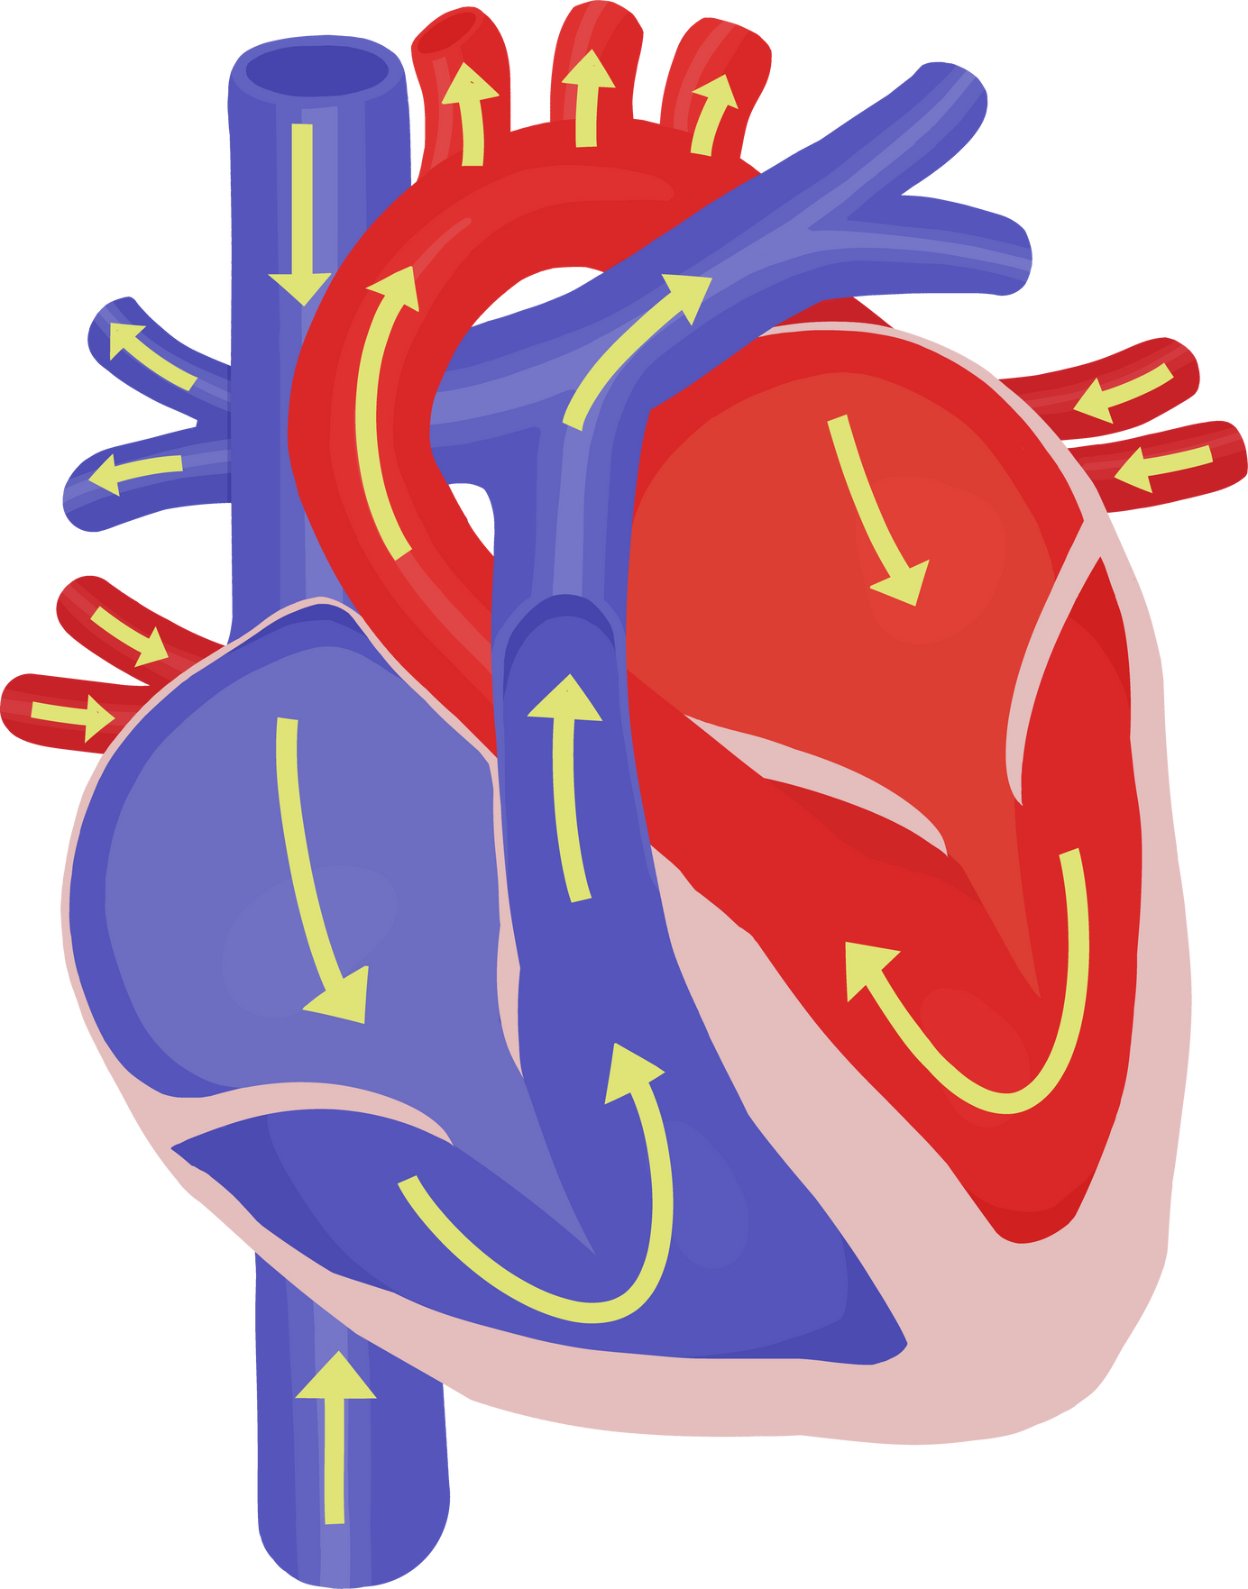

First Presentation
Two More Important Clues
ECHO
Haematology input
Advised for workup for possible pro-thrombotic state with protein electrophoresis, JAK2 mutation- Showed IgM Paraproteinaemia with Lambda free light chains in Urine ?MGUS
EF 50-60%, Diastolic dysfunction

Slide 7









First Presentation
Sequale
Next Steps
Investigated cause of hepatomegaly with:
Trans-jugular liver biopsy
Initial Steps
Further Plans
Treatment dose of Clexane stopped
  Follow up in Liver clinic to discuss the results of liver biopsy
  Sigmoidoscopy booked
  C2C referral sent for haematology OPD follow up for ?MGUS

Slide 8


DIFFERENTIAL
DIAGNOSES?

Slide 9













DIFFERENTIAL DIAGNOSIS LIST
Infiltrative Liver Diseases
Congestive Hepatopathy
Sarcoidosis
Lymphoma involving liver
Amyloidosis
Leukemia (esp. CLL or AML)
Hemochromatosis
Wilson’s disease
Glycogen storage diseases
Right heart failure / constrictive pericarditis
Fat Accumulation or Metabolic Disorders
Malignancy
Metastatic liver disease
Hepatocellular carcinoma (HCC)
NAFLD/NASH
Alcoholic liver disease
Storage Diseases
Other Rare Mimics
Gaucher disease
Niemann-Pick disease
Primary biliary cholangitis (PBC)
Primary sclerosing cholangitis (PSC)
Tuberculosis of the liver

Slide 10
DIFFERENTIAL DIAGNOSIS LIST
Feature | Sarcoidosis | Hepatic Amyloidosis | Lymphoma/Leukemia | Hemochromatosis | NAFLD/NASH | Metastatic Liver Disease | Right Heart Failure
Hepatomegaly | Mild to moderate | Massive, firm, non-tender | Moderate, may be nodular | Mild to moderate | Mild to moderate | Often nodular or hard | Tender, congestive
Jaundice | Rare | Absent or late | Rare | Late stage | Rare | Variable | Possible
Alkaline Phosphatase (ALP) | Mildly ↑ | Markedly ↑ | Mild to moderate ↑ | Mild ↑ | Mild ↑ | Often ↑ | Mild ↑
Bilirubin | Normal | Normal or mildly ↑ | Normal | ↑ in late stages | Normal | ↑ if biliary involvement | May be ↑
Systemic Symptoms | Fever, cough, uveitis | Nephrotic syndrome, fatigue, neuropathy, cardiomyopathy | B symptoms (fever, weight loss, sweats) | Skin pigmentation, diabetes | Metabolic syndrome | Weight loss, primary cancer | Edema, dyspnea, raised JVP
Liver Biopsy | Non-caseating granulomas | Congo red +ve amyloid (apple-green birefringence) | Malignant infiltration | Iron deposition (Prussian blue stain) | Steatosis ± inflammation | Malignant cells | Congestion, centrilobular fibrosis
Serum Protein Electrophoresis (SPEP) | Normal | Monoclonal spike (AL type) | May show abnormalities | Normal | Normal | Normal | Normal
Other Key Clues | Hilar lymphadenopathy on CXR | Macroglossia, periorbital purpura, restrictive cardiomyopathy | Abnormal WBCs, lymphadenopathy | High ferritin, HFE gene | Obesity, insulin resistance | History of malignancy | Echo: RV failure signs, elevated JVP

Slide 11
DIFFERENTIAL DIAGNOSIS LIST
Feature | Sarcoidosis | Hepatic Amyloidosis | Lymphoma/Leukemia | Hemochromatosis | NAFLD/NASH | Metastatic Liver Disease | Right Heart Failure
Hepatomegaly | Mild to moderate | Massive, firm, non-tender | Moderate, may be nodular | Mild to moderate | Mild to moderate | Often nodular or hard | Tender, congestive
Jaundice | Rare | Absent or late | Rare | Late stage | Rare | Variable | Possible
Alkaline Phosphatase (ALP) | Mildly ↑ | Markedly ↑ | Mild to moderate ↑ | Mild ↑ | Mild ↑ | Often ↑ | Mild ↑
Bilirubin | Normal | Normal or mildly ↑ | Normal | ↑ in late stages | Normal | ↑ if biliary involvement | May be ↑
Systemic Symptoms | Fever, cough, uveitis | Nephrotic syndrome, fatigue, neuropathy, cardiomyopathy | B symptoms (fever, weight loss, sweats) | Skin pigmentation, diabetes | Metabolic syndrome | Weight loss, primary cancer | Edema, dyspnea, raised JVP
Liver Biopsy | Non-caseating granulomas | Congo red +ve amyloid (apple-green birefringence) | Malignant infiltration | Iron deposition (Prussian blue stain) | Steatosis ± inflammation | Malignant cells | Congestion, centrilobular fibrosis
Serum Protein Electrophoresis (SPEP) | Normal | Monoclonal spike (AL type) | May show abnormalities | Normal | Normal | Normal | Normal
Other Key Clues | Hilar lymphadenopathy on CXR | Macroglossia, periorbital purpura, restrictive cardiomyopathy | Abnormal WBCs, lymphadenopathy | High ferritin, HFE gene | Obesity, insulin resistance | History of malignancy | Echo: RV failure signs, elevated JVP

Slide 12










First Presentation
Amyloid Histology & Immunochemistry Report
  Congo Red Staining
  Immunochemistry
Demonstrated presence of Amyloid
Amyloid stained with antibodies to lambda light chains

Slide 13
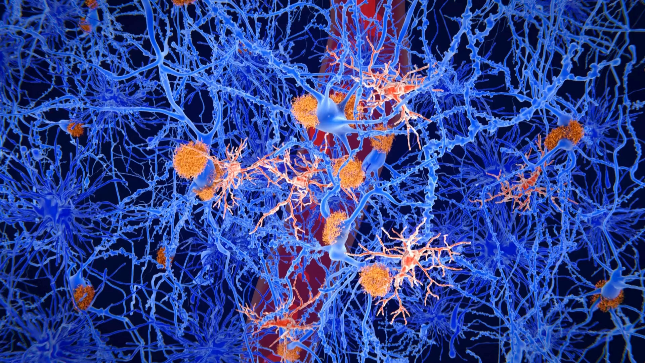
SYSTEMIC
AL
AMYLOIDOSIS

Slide 14
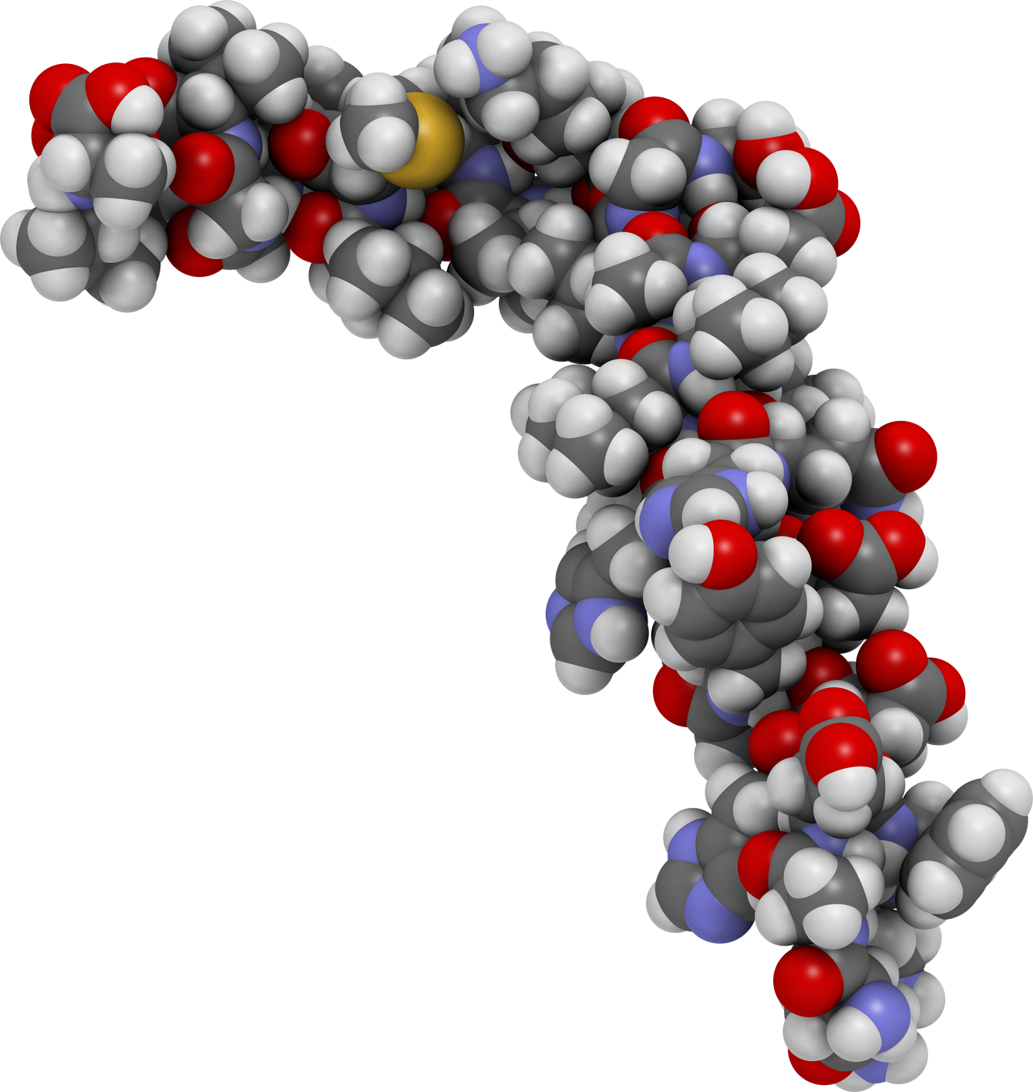
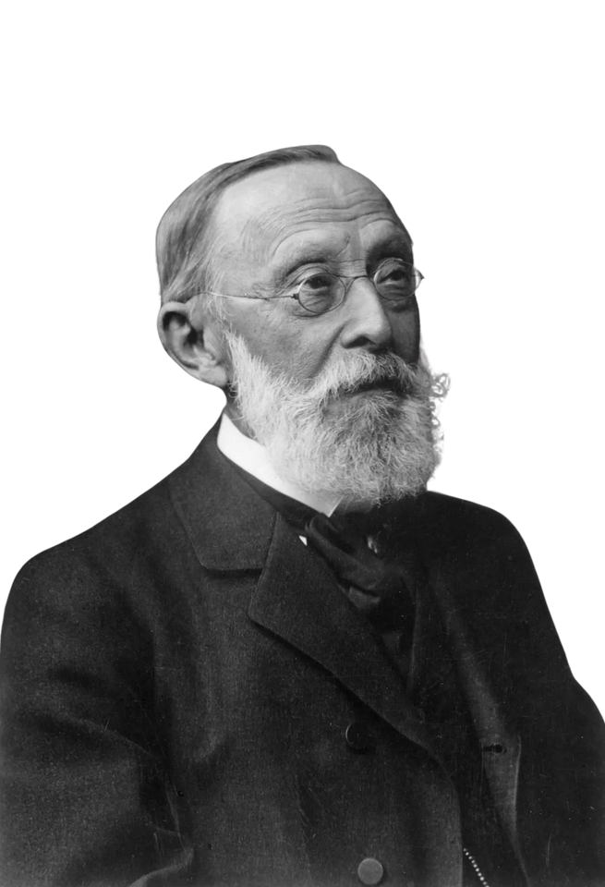


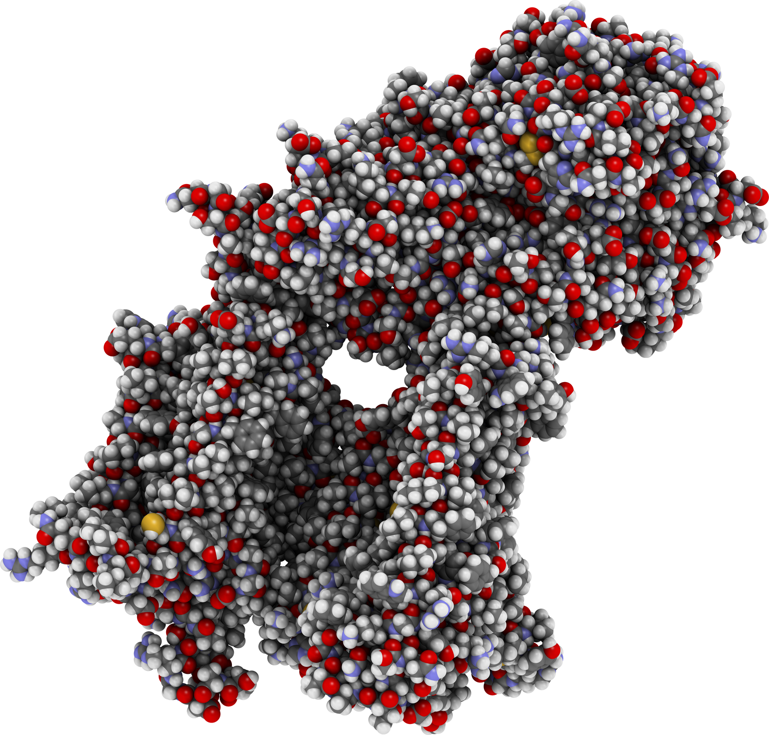

Disease caused by tissue damage due to these protein deposits
AMYLOIDOSIS
Starch-Like
Proteins with Abnormal Shape
Rudolph Virchow
Stick together
Tissue deposits that stain Blue with Iodine
Deposit in Tissues

Slide 15











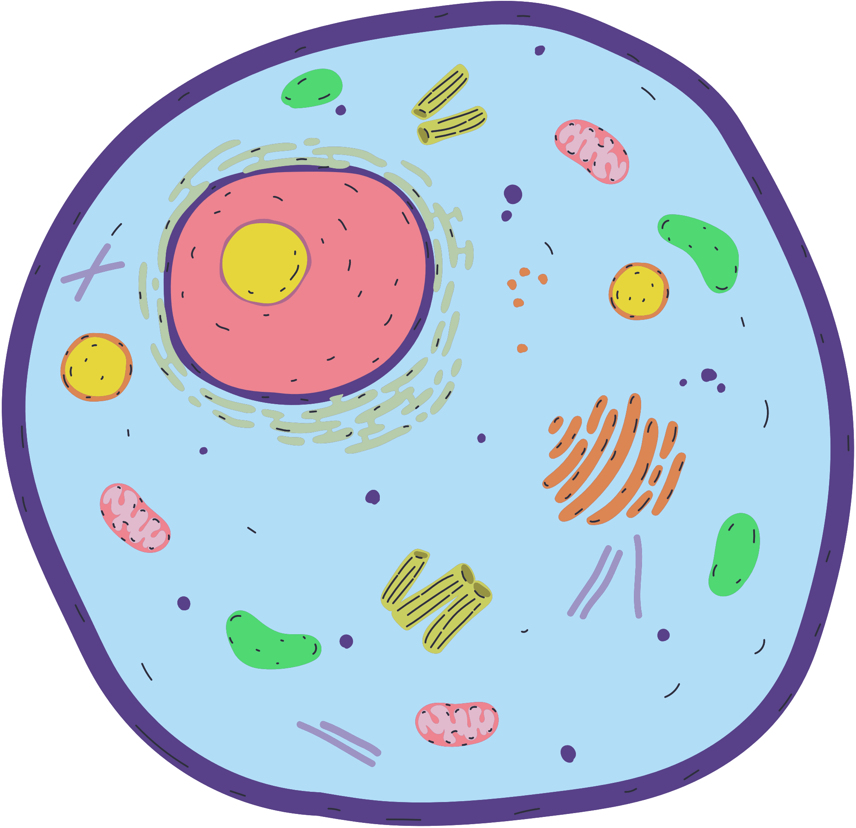

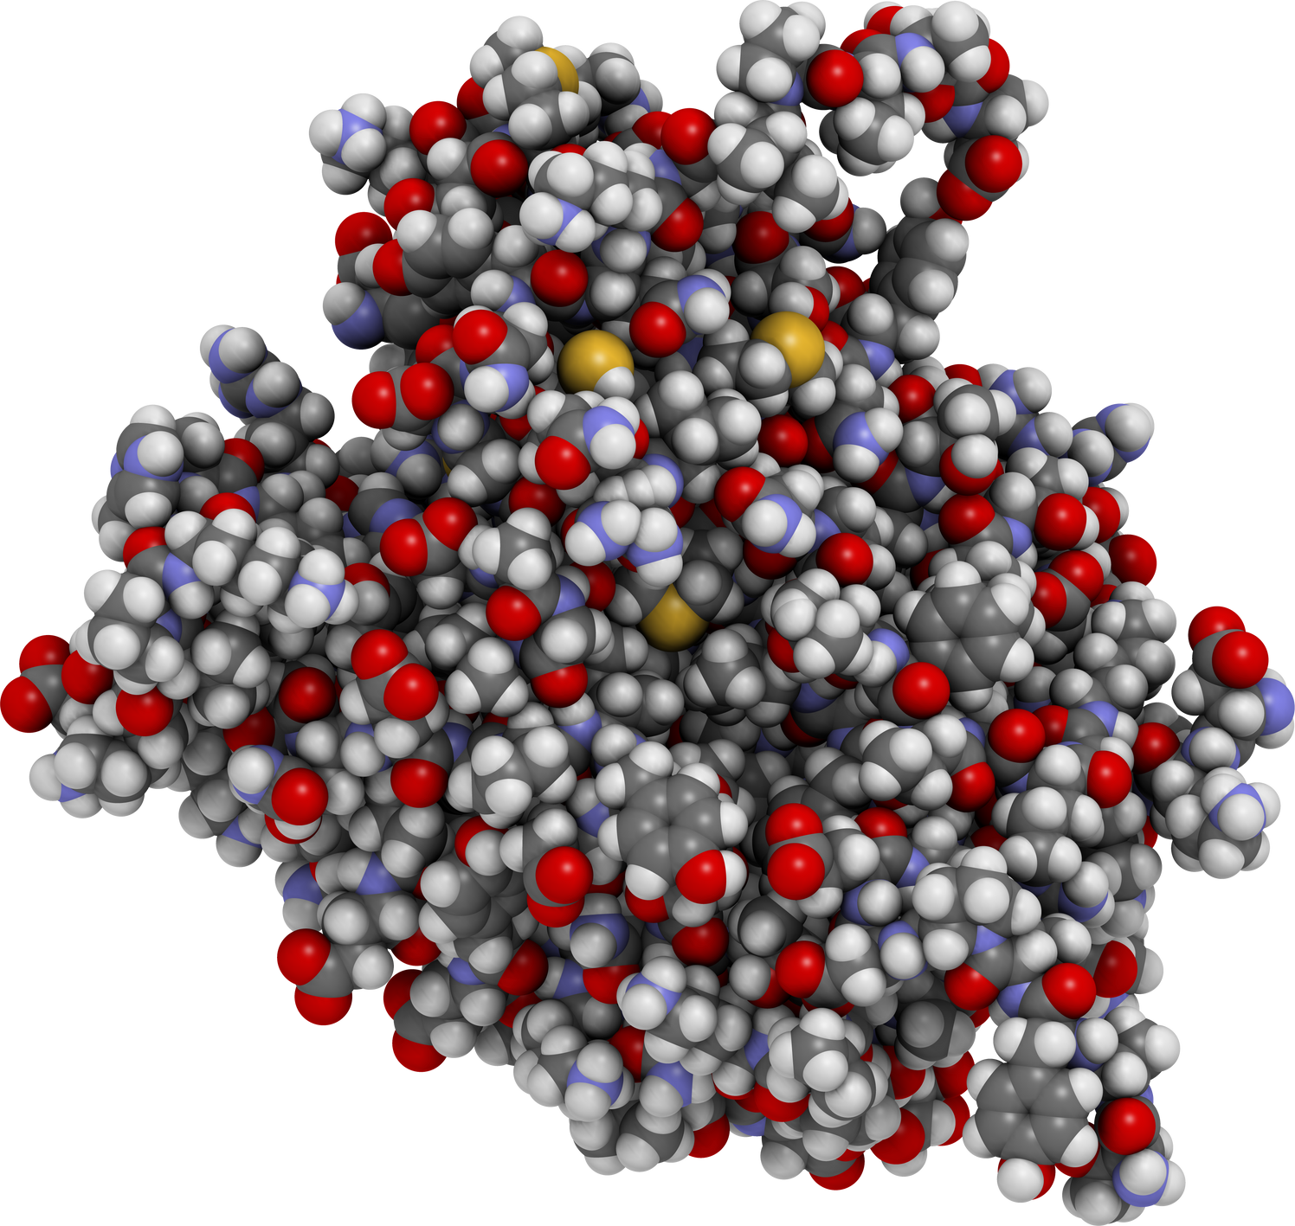
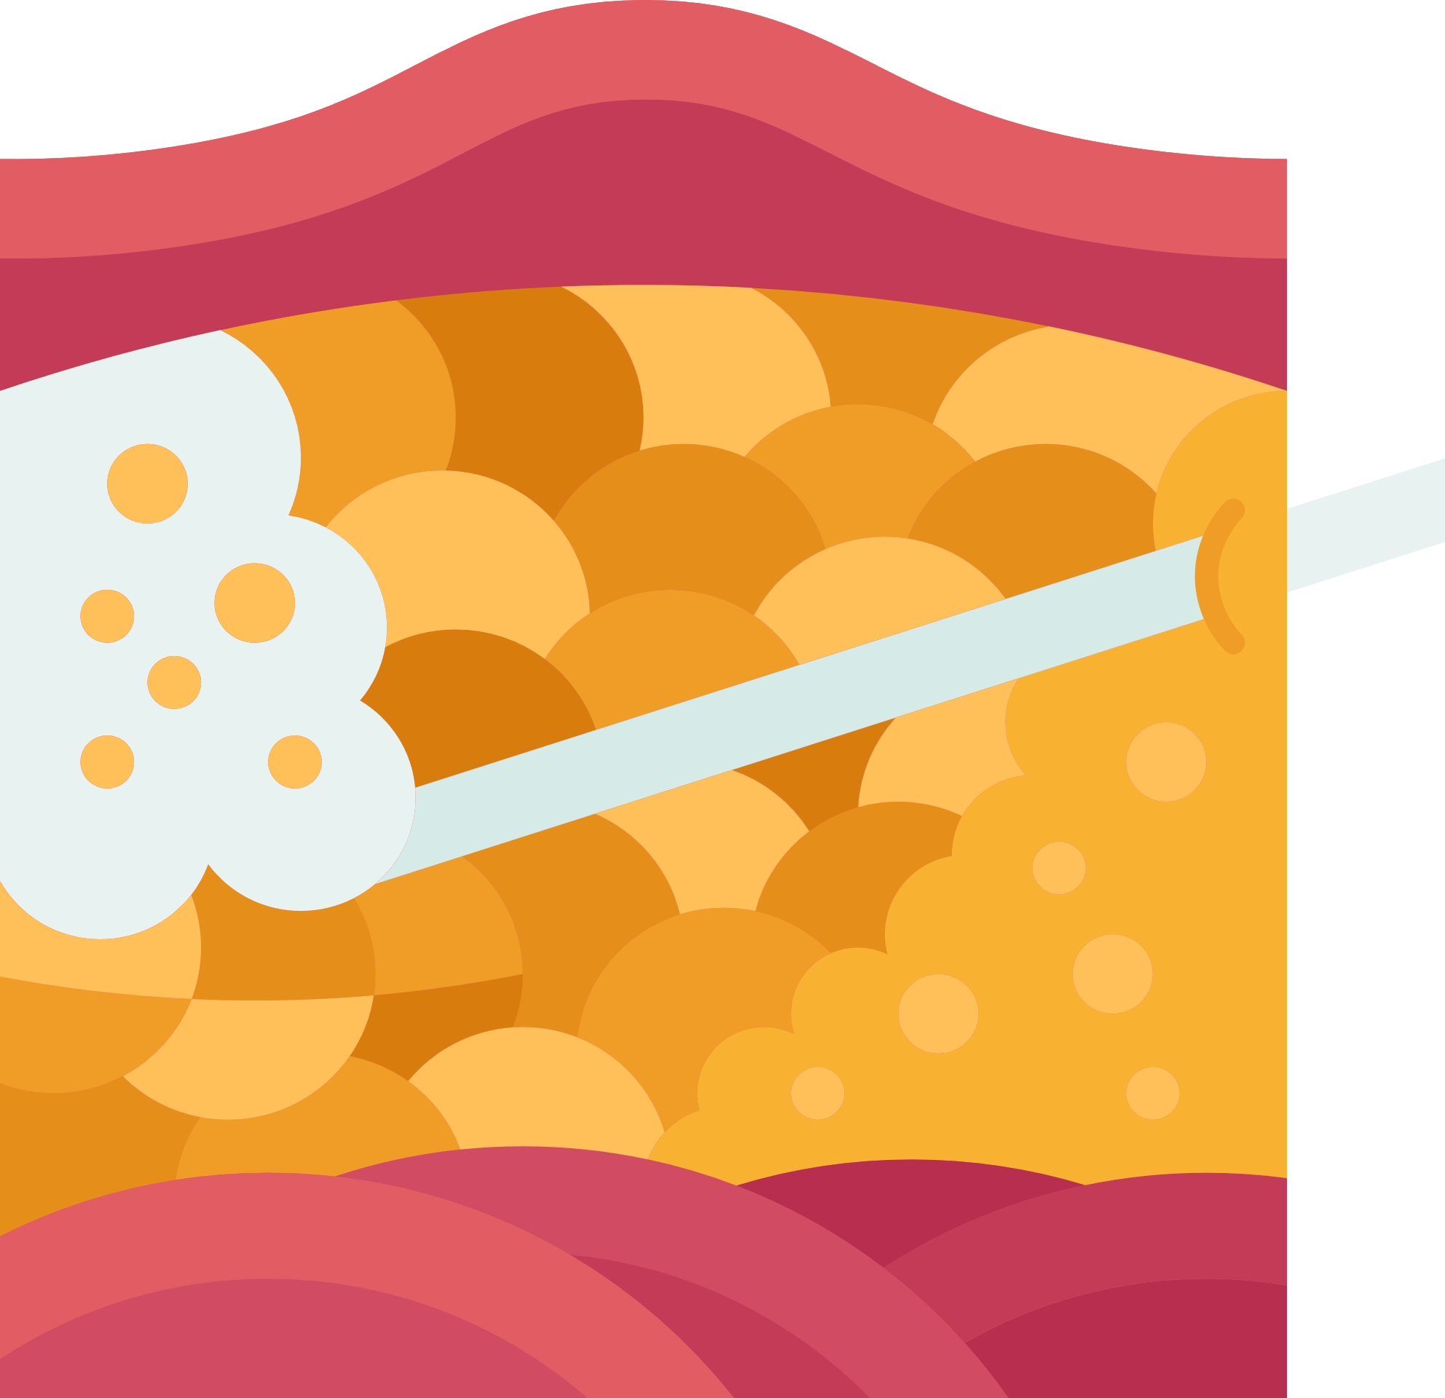


Folded Correctly
Folded InCorrectly
Destroyed by
Proteases
AMYLOIDOSIS
1. Normal Protein- Enormous amount- Small fraction fold incorrectly
2. Abnormal Protein- Normal amount- Fold incorrectly
Beta-Sheet Deposit
in Extracellular Spaces
Too many/ Can’t break
This shet is endless

Slide 16

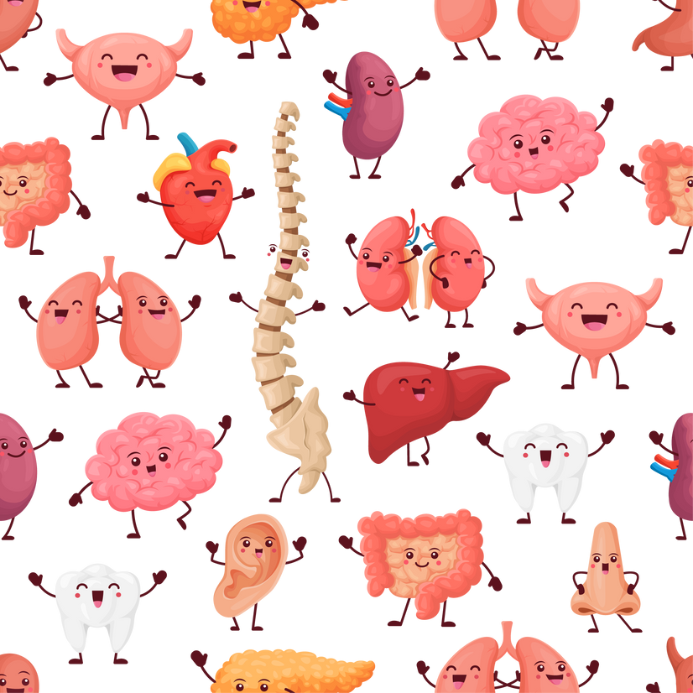


AMYLOIDOSIS
Systemic
(Multiple organ systems)
Localized
(One organ)
Primary
Amyloidosis
= Main Problem
Secondary
Underying disease
= Causing protein deposit
N.B- Not Accurate as underlying disease identified even in primary

Slide 17


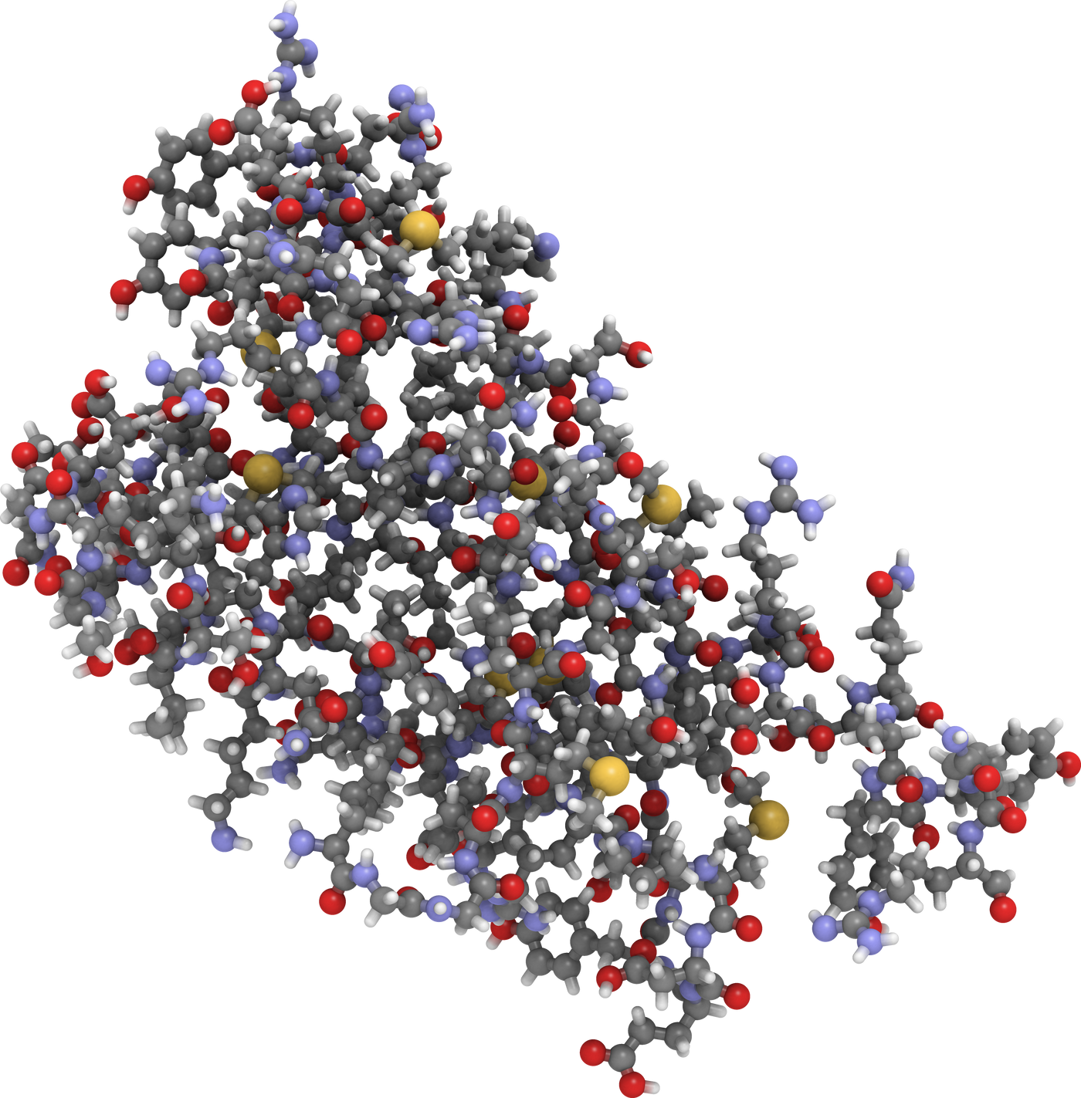
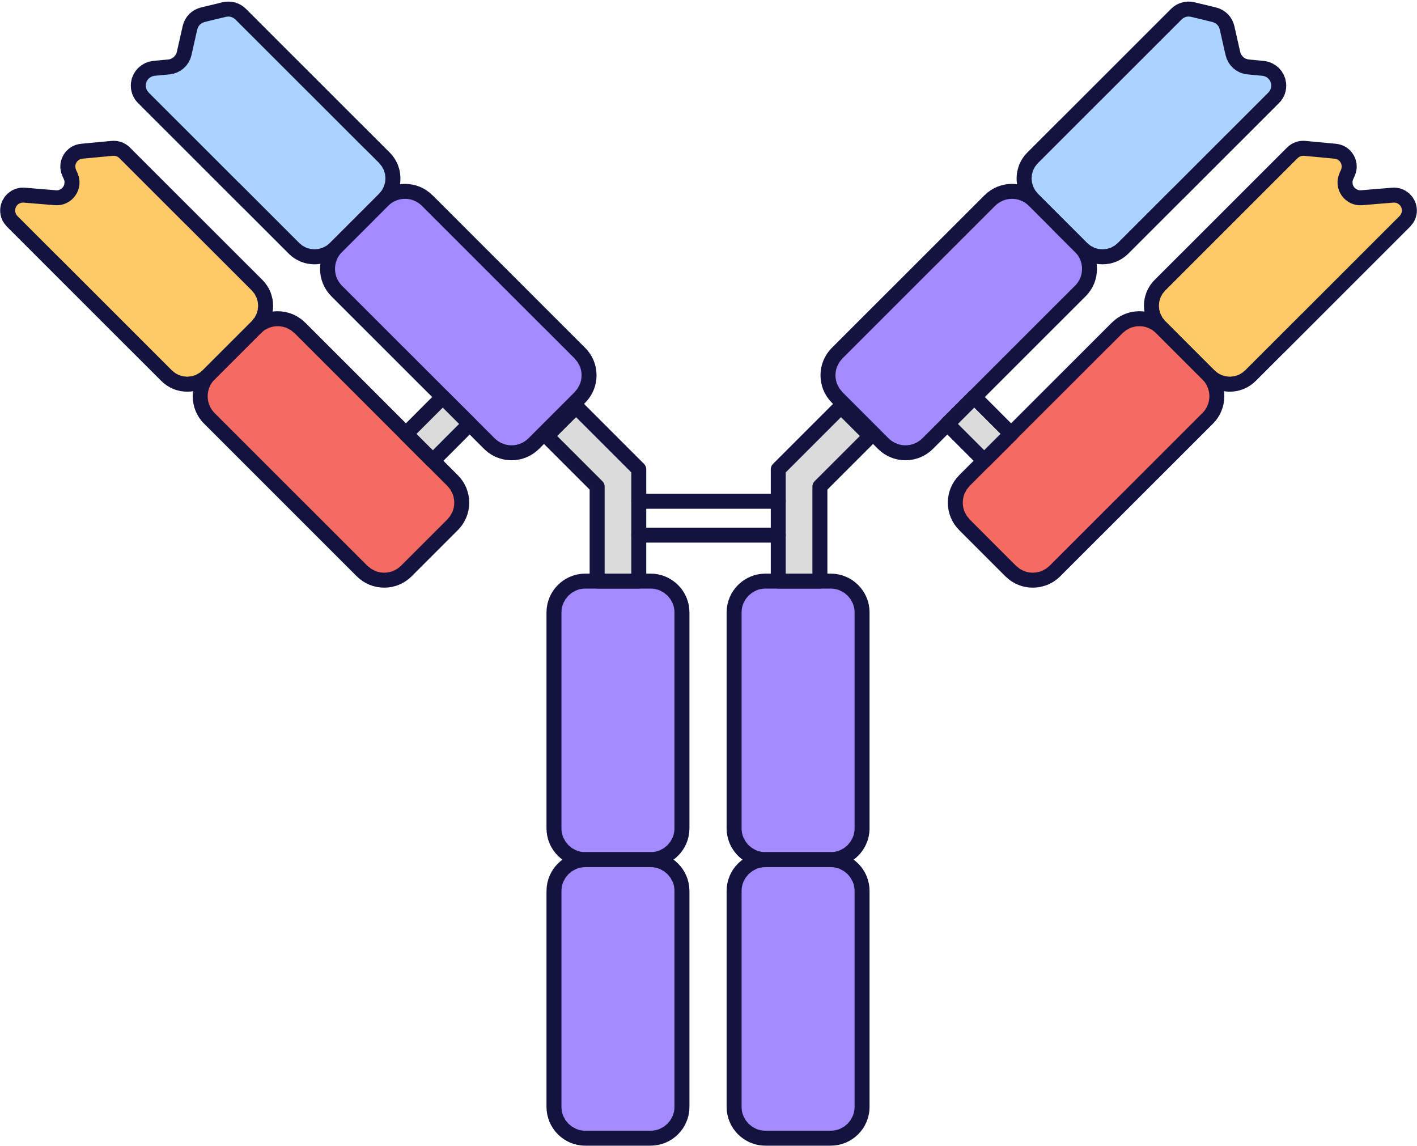

AL
AMYLOIDOSIS
(previously Primary)
AL Proteins
and deposit in Tissues
Light Chains
Immunoglobulin
Misfolded and Deposited
Plasma Cell Disorders
MULTIPLE
MYELOMA

Slide 18
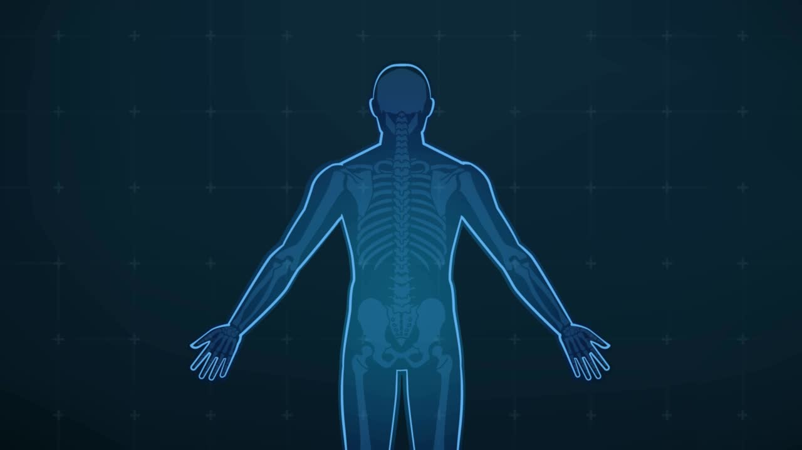
AA
AMYLOIDOSIS
(previously Secondary)
AA Proteins
and deposit in Tissues
Serum Amyloid A
Increased Serum Amyloid A, some gets misfolded
Acute Phase Reactants
Chronic Inflammation
  Rheumatoid Arthritis
  IBD
  Cancers
  Familial mediterranean fever

Slide 19
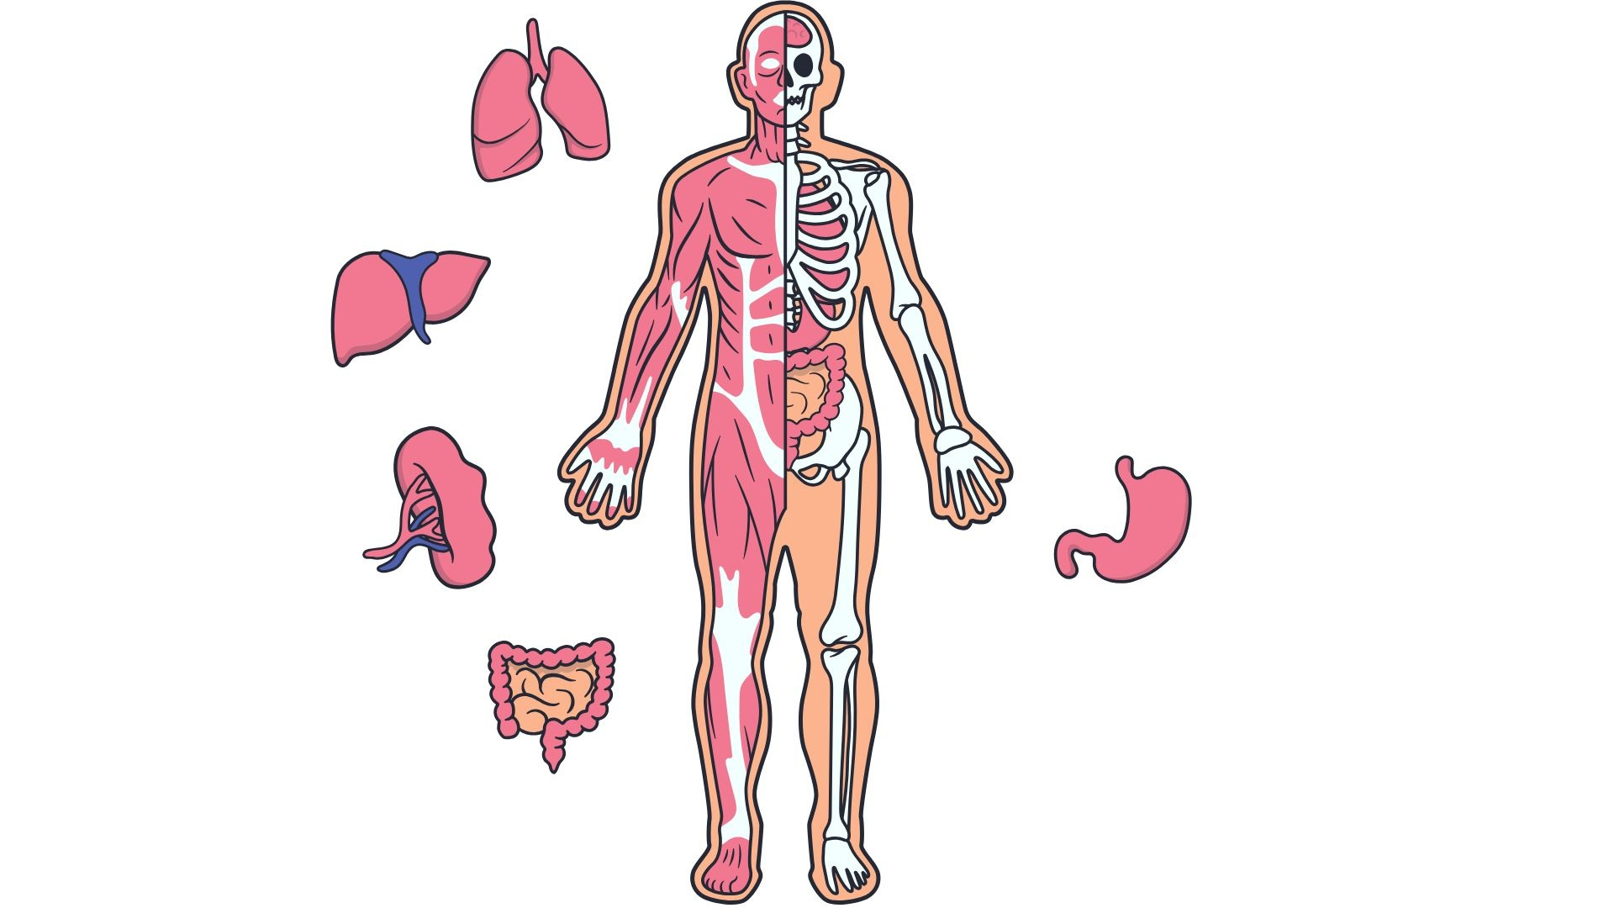

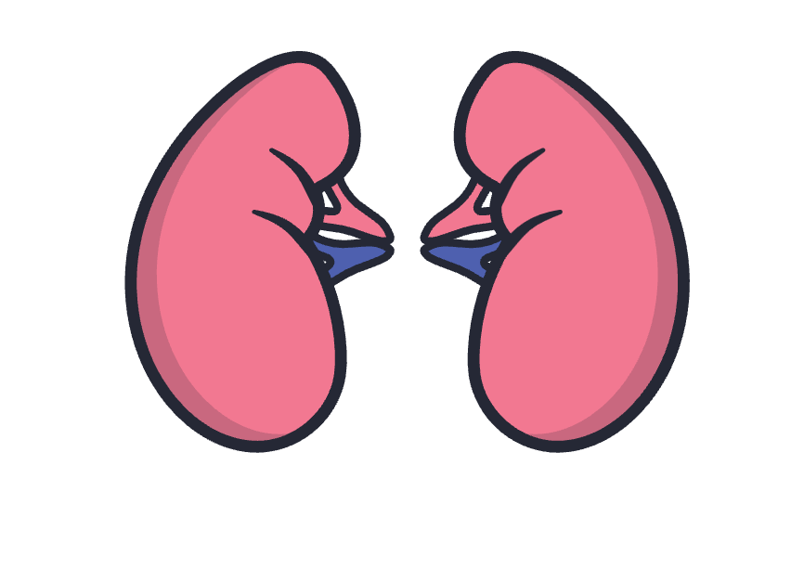


Slide 20
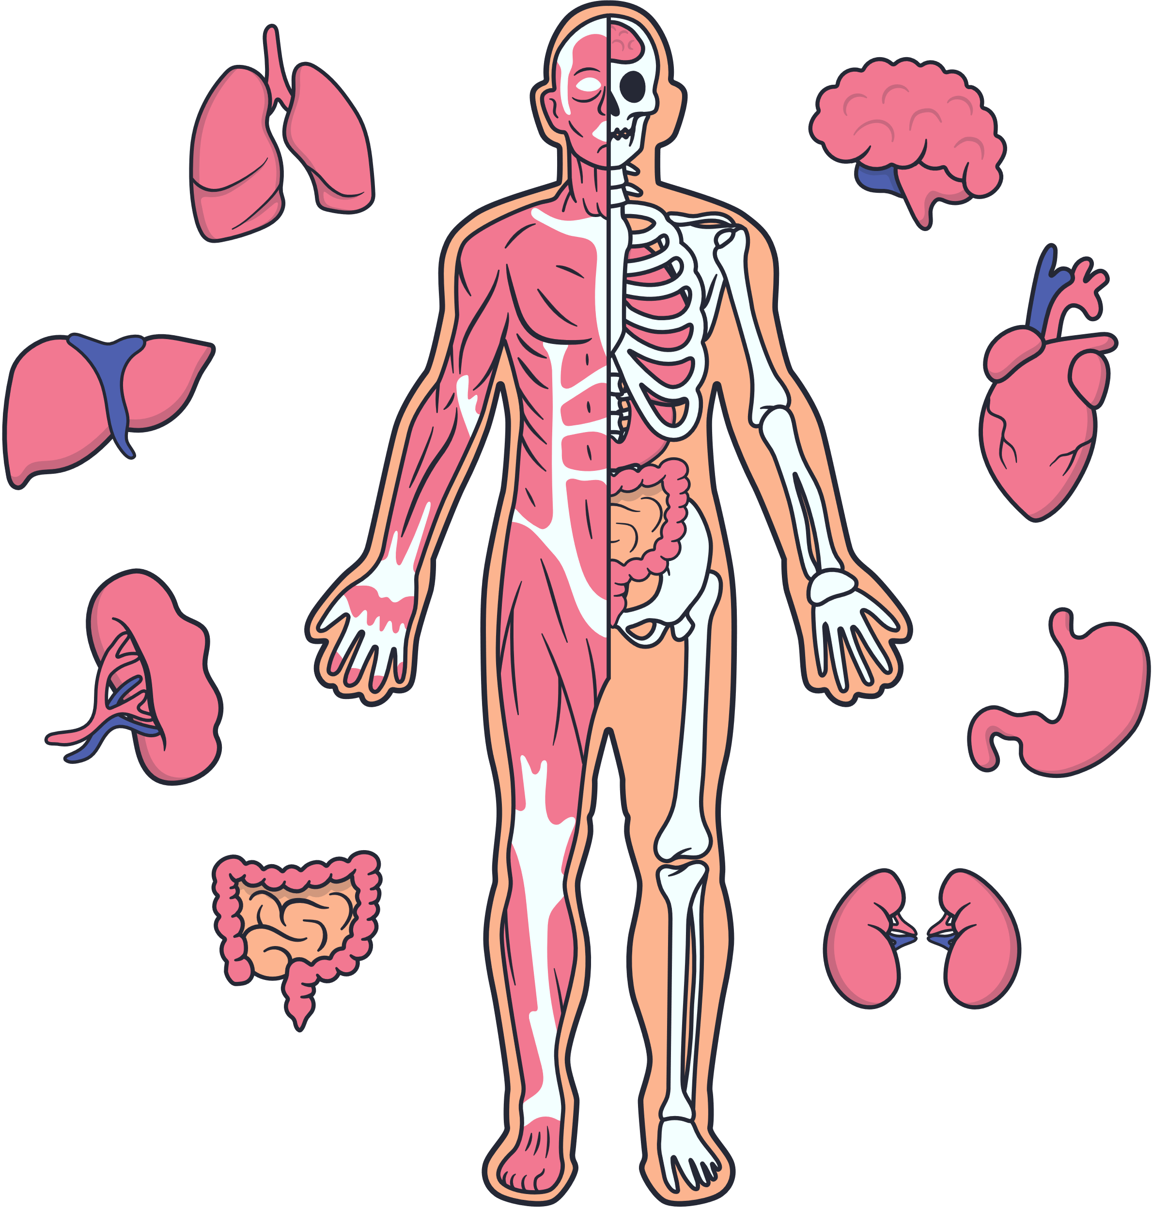
KIDNEYS
Affects Podocytes causing Nephrotic Syndrome:
  Proteinuria causing Hypoalbuminaemia
  Oedema (due to increased oncotic pressure)
  Hyperlipidaemia due to opposite hypoalbuminaemia

Slide 21

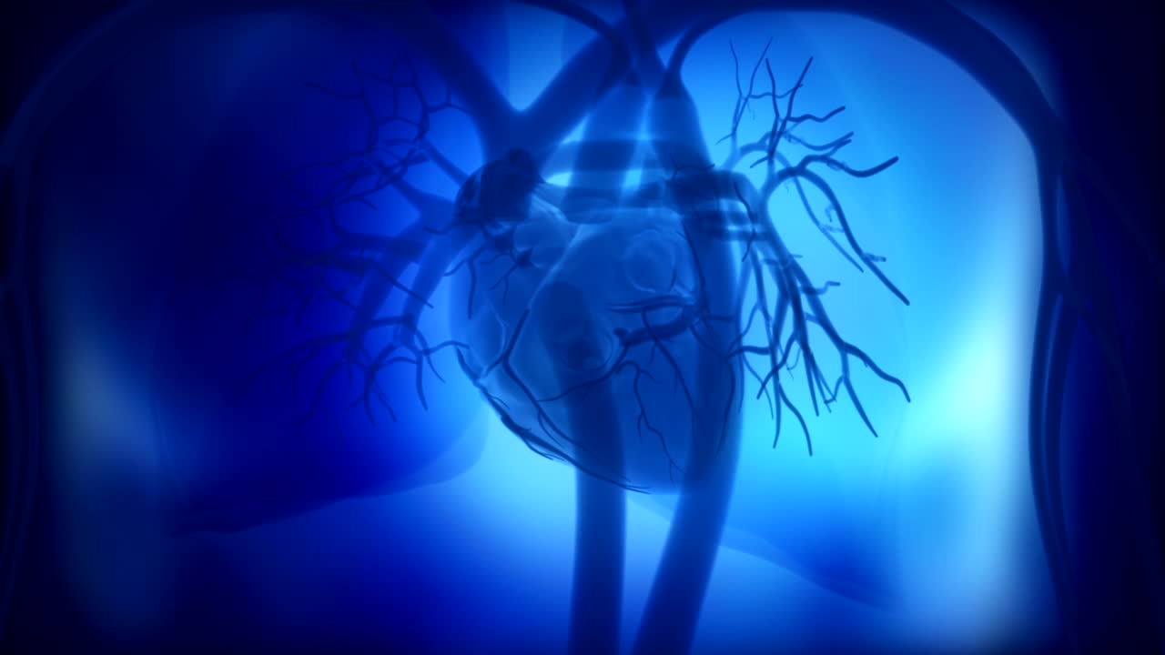
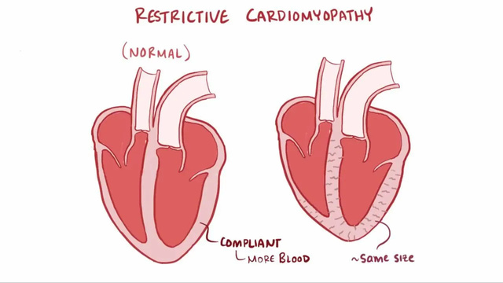
HEART
CHF
Restrictive Cardiomyopathy
Stiff Heart walls
Interfere with Electrical Conduction
Arrhythmia

Slide 22

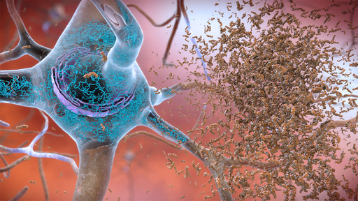


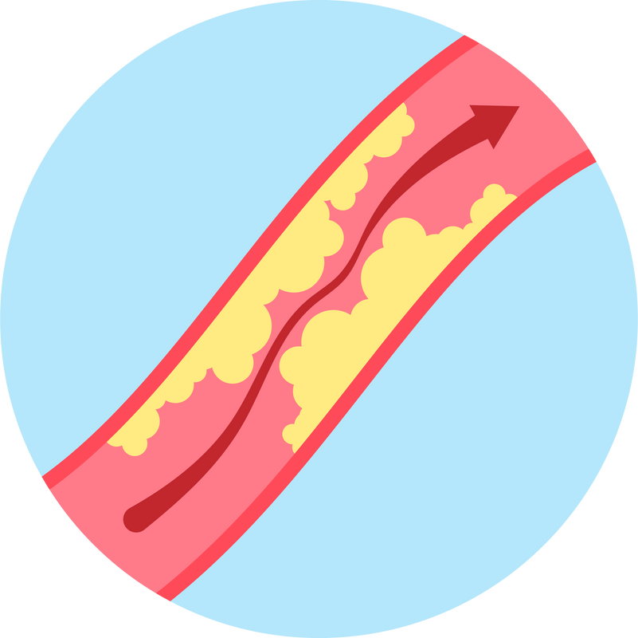
AMYLOIDOSIS
LOCALISED
ALZHEIMER’S DEMENTIA
A-β- Peptides> Plaques
AMYLOID
ANGIOPATHY
Risk of haemorrhage

Slide 23
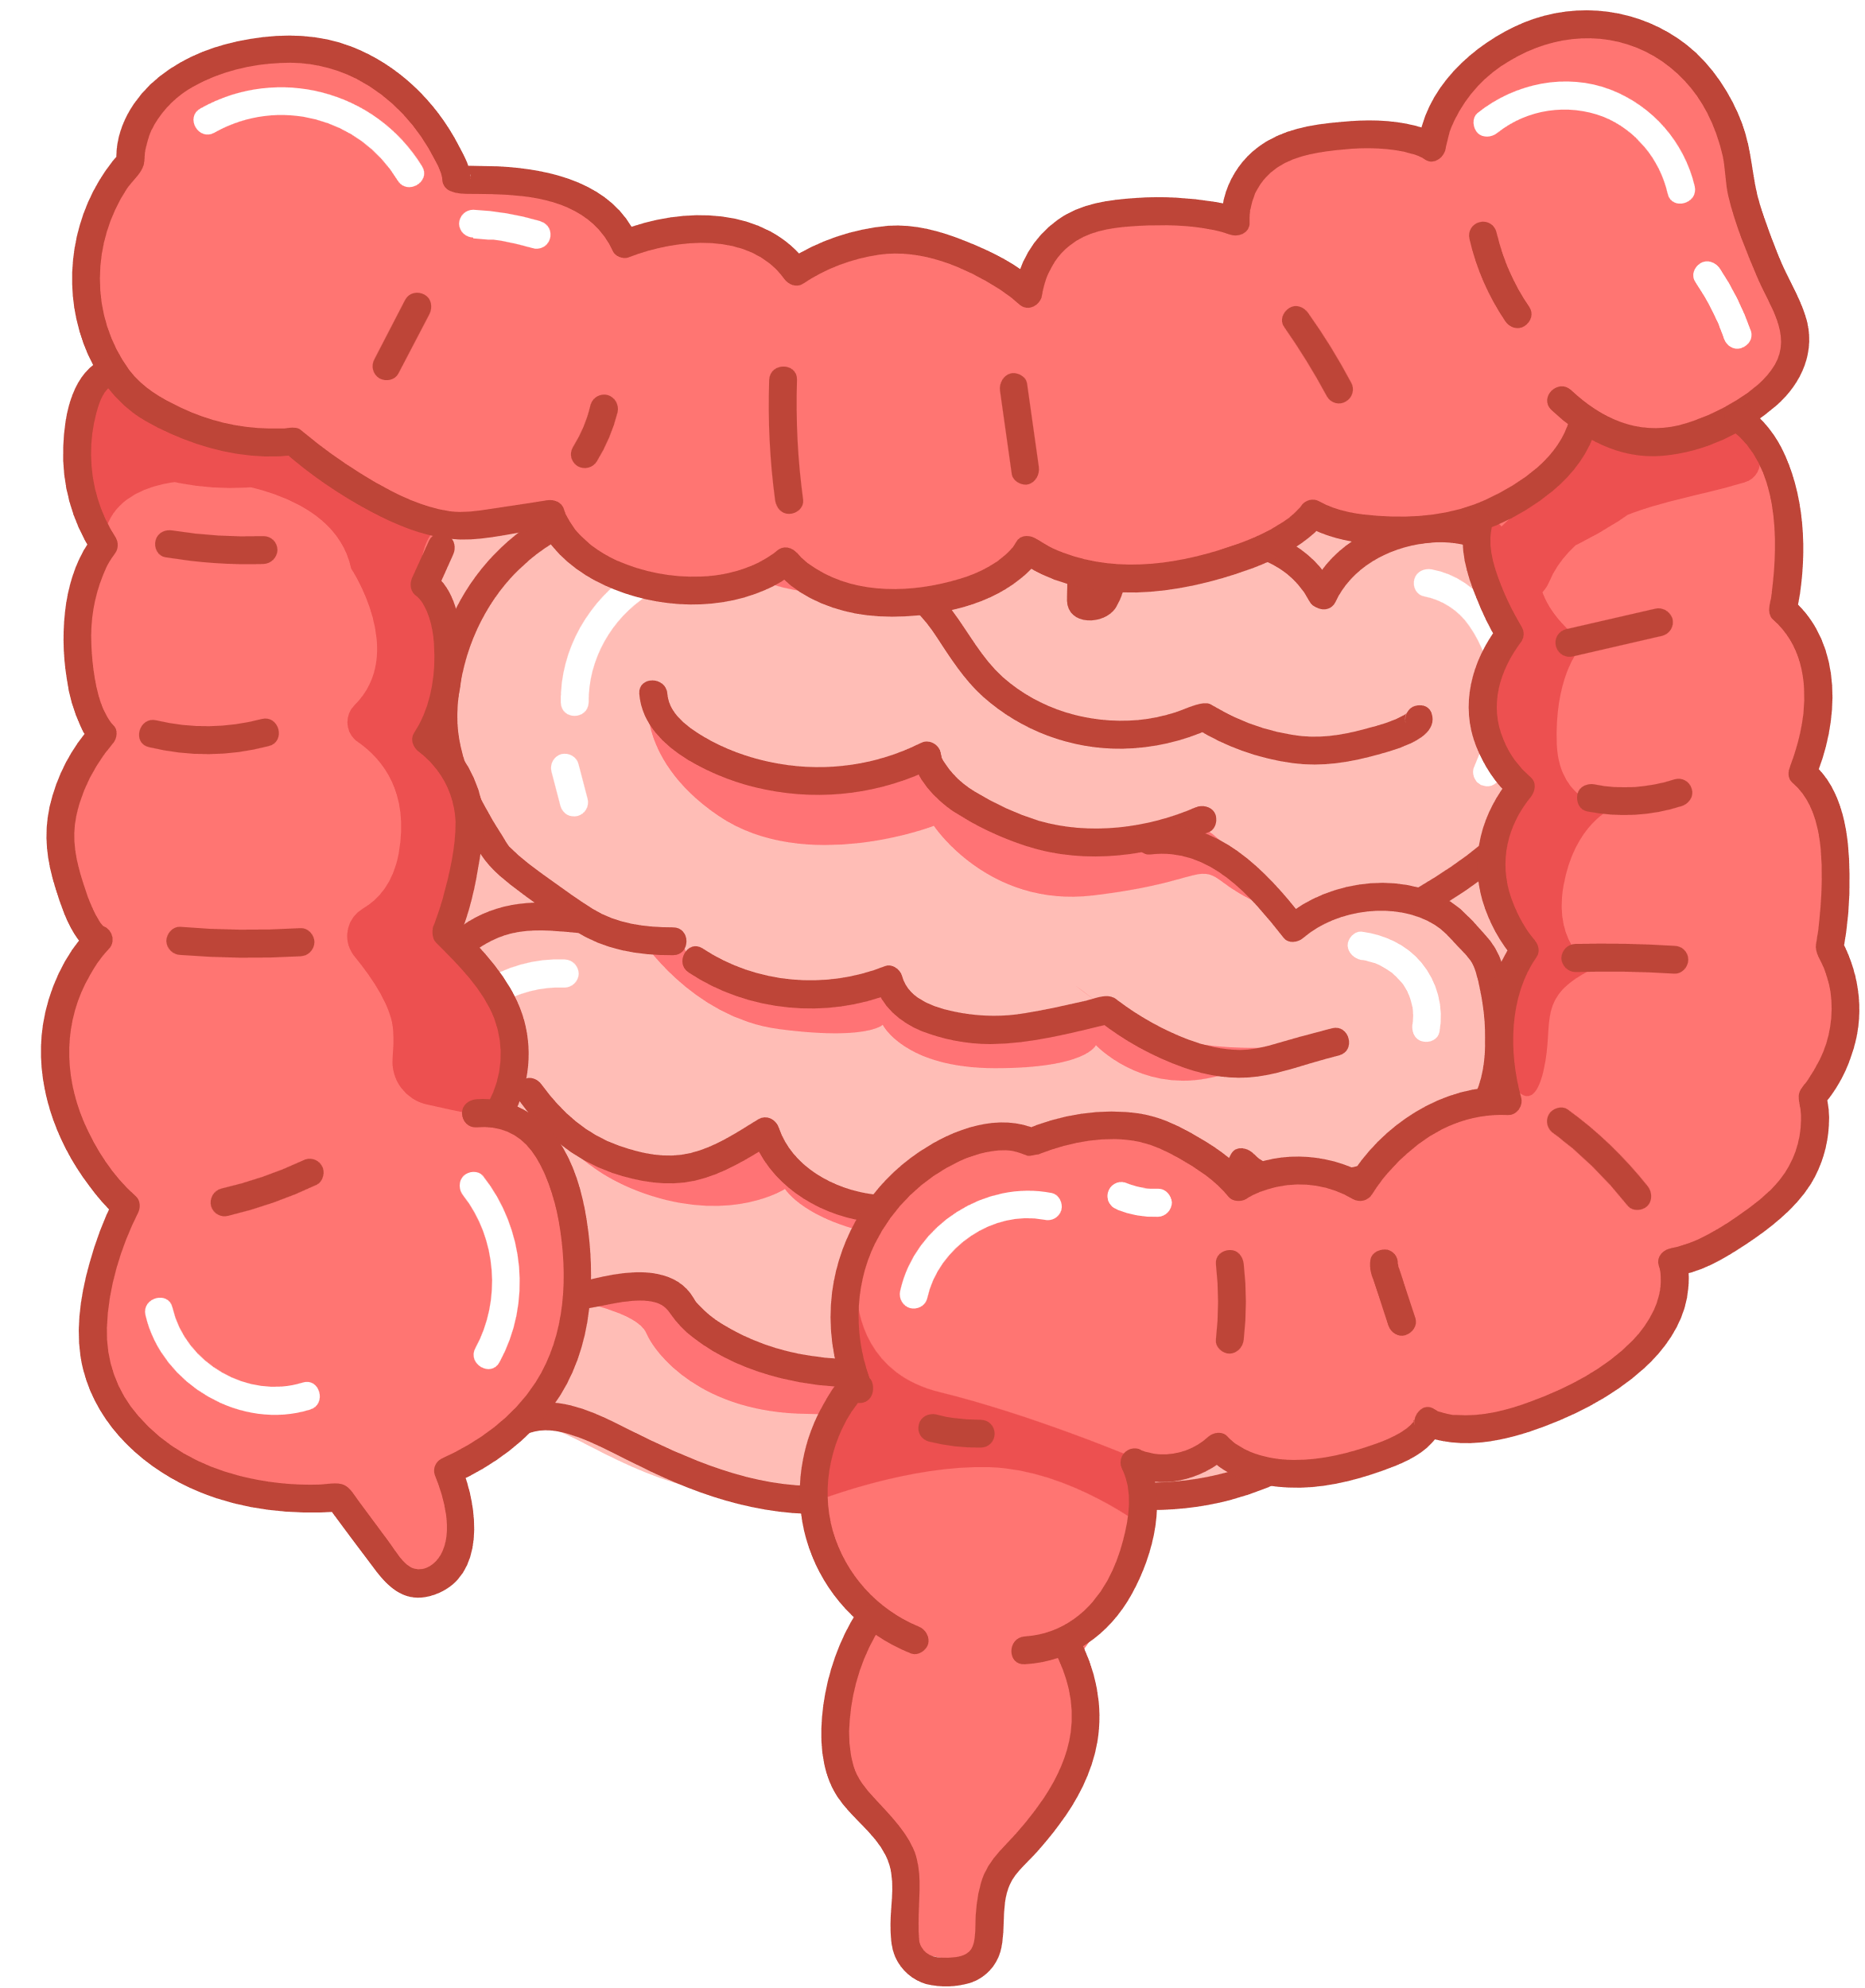
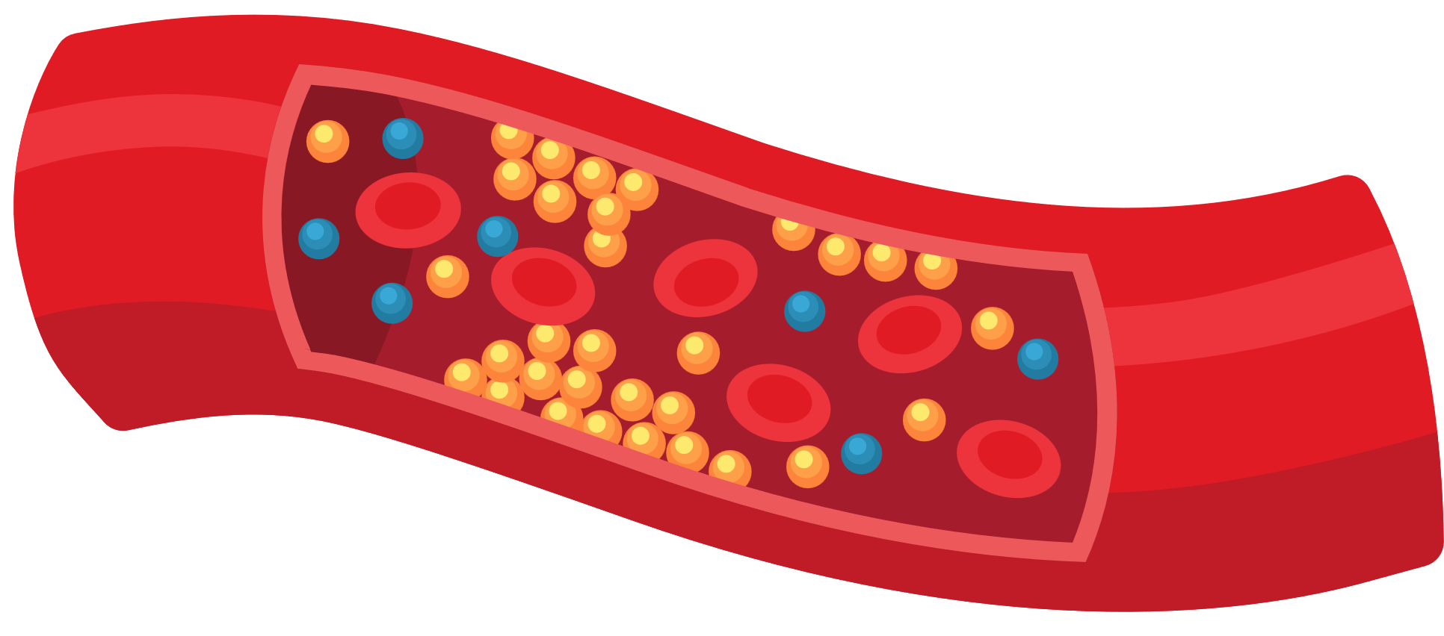
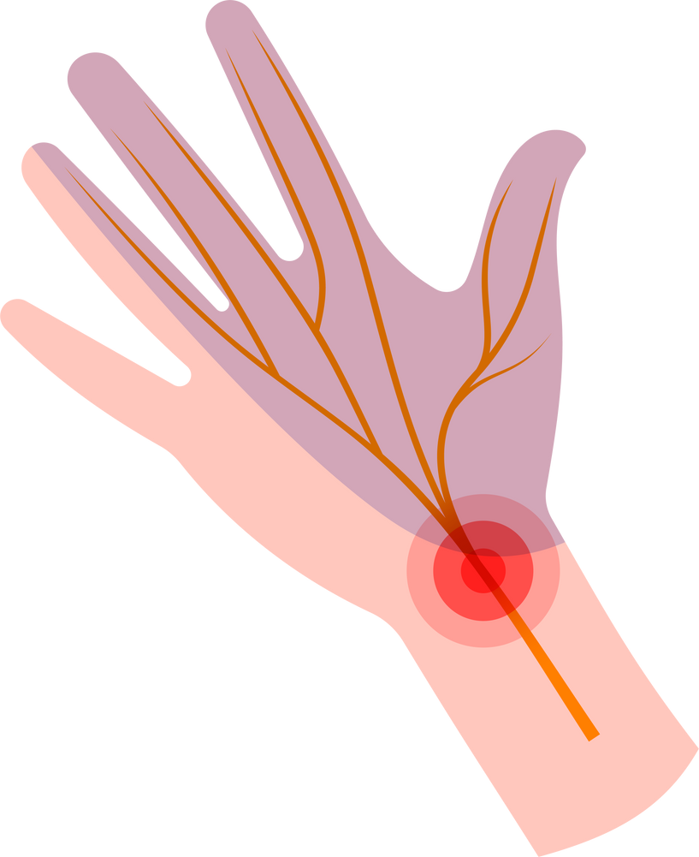
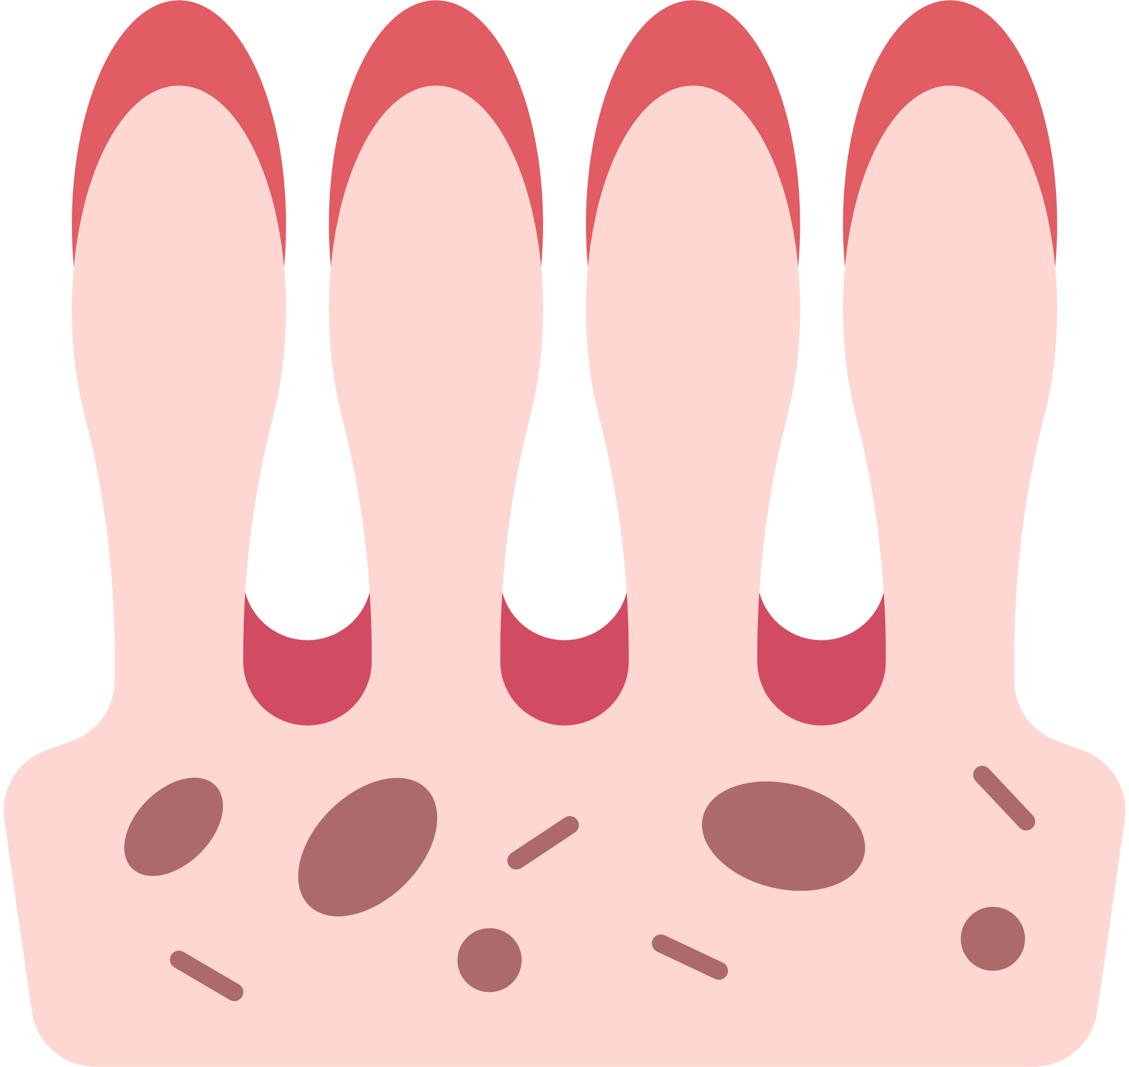
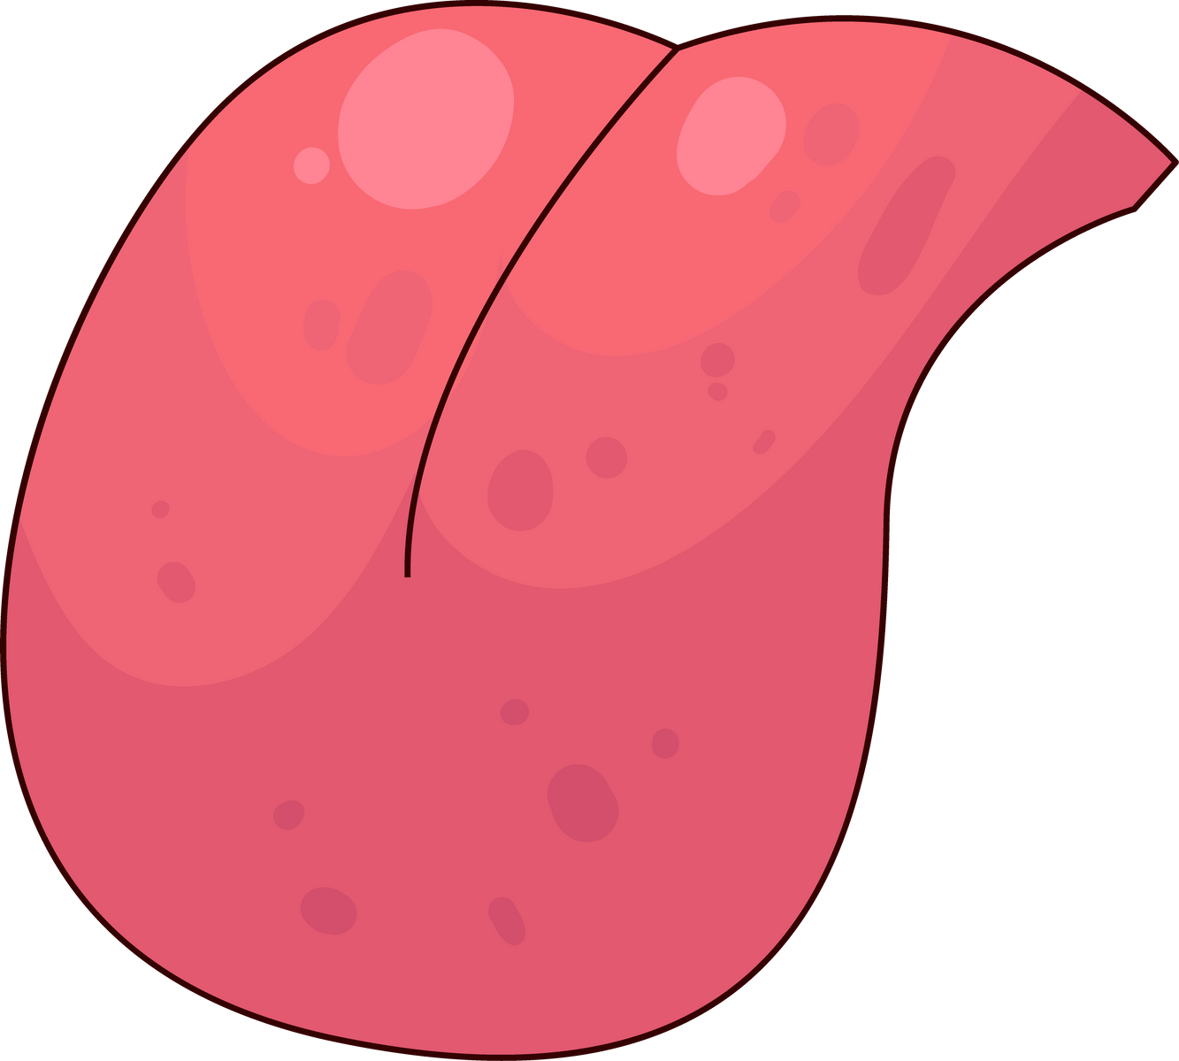
OTHERS
Autonomic nervous sytem
Sensory/Motor
Enlarged
Malabsorption
Intestinal
Villi
Amyloid deposits

Slide 24


AMYLOIDOSIS
LOCALISED
PANCREAS
Death of Beta cells due to islet amyloid peptide deposition called Amylin
Increased Insulin causing
Type 2 Diabetes

Slide 25








SYSTEMIC SYMPTOMS
Kidneys
Heart
Intestinal
  Swelling in face, ankles, legs
  Palpitations & SOB
  Malabsorption & weight loss
Large tongue
Nerves
Central Nervous System
  Interferes with speech & swallowing
  Noisy breathing at night
  Numbness/pain in fingers & toes
  Diarrhoea and constipation
  Orthostatic hypotension
  Often spared
  Alzheimer’s

Slide 26
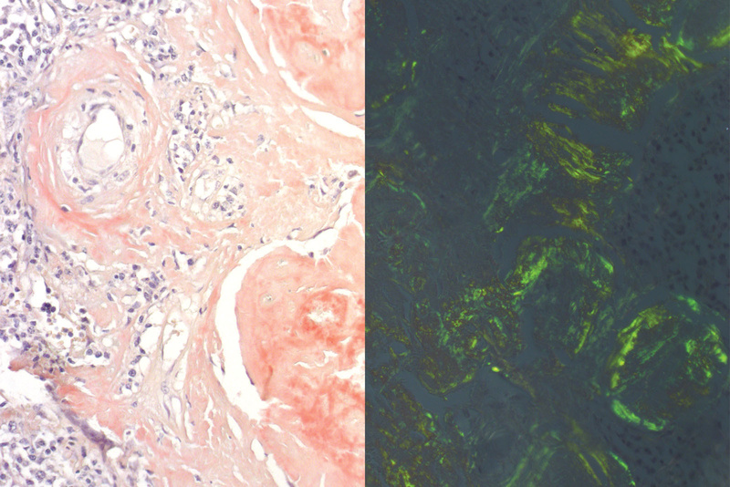
AMYLOIDOSIS
Biopsy of Involved Organ
Fat Pad Biopsy
DYE: CONGO RED STAIN
POLARIZED LIGHT
AMYLOID= PINK
AMYLOID= APPLE GREEN

Slide 27
A 40YO man being examined for exercise intolerance. Patient develops SOB 5 mins after exercise. Patient also complains of knee pain that worsens throughout the day and improves with rest. Family history is significant for an uncle with ulcerative colitis. ECHO reveals thickening of walls of both ventricles. ECG reveals low voltage electrical activity. Biopsy of heart reveals infiltration that has apple green colour under polarized light.
Which of the following has most likely resulted in this patient’s cardiac abnormalities?
Mutation in transthyretin
Chronic RA
IBD
Multiple myeloma

Slide 28
A 40YO man being examined for exercise intolerance. Patient develops SOB 5 mins after exercise. Patient also complains of knee pain that worsens throughout the day and improves with rest. Family history is significant for an uncle with ulcerative colitis. ECHO reveals thickening of walls of both ventricles. ECG reveals low voltage electrical activity. Biopsy of heart reveals infiltration that has apple green colour under polarized light. Which of the following has most likely resulted in this patient’s cardiac abnormalities?
Mutation in transthyretin
Familial amyloid cardiomyopathy is caused by deposition of mutant transthyretin in the heart, causing restrictive CMP. TTR is produced by liver, normal form is deposited in the heart of elderly patients causing senile cardiac amyloidosis. On the other other hand, mutant form of TTR leads to hereditary amyloidosis seen in younger people.
In Short,
TTR= produced by liver
Normal TTR- Senile
Mutant TTR- Young

Slide 29
Amyloidosis in pancreas causes pancreatic beta cell damage due to:
Inflammation due to deposition of amylin in islets of langerhans
Inflammation due to immune complex deposition in islets of langerhans
Inflammation due to deposition of AL amyloid in islets of langerhans
Autoimmune destruction

Slide 30
Amyloidosis in pancreas causes pancreatic beta cell damage due to:
Inflammation due to deposition of amylin in islets of langerhans
Inflammation due to immune complex deposition in islets of langerhans
Inflammation due to deposition of AL amyloid in islets of langerhans
Autoimmune destruction

Slide 31
A 56 year old man presented with bubbly and frothy urine, urinalysis reveals >4g of protein over 24hrs. Biopsy taken from kidney reveals deposition in the mesangium, which appears red on Congo stain and have an apple green colour under polarized light. This stained inclusion is most likely made of which of the following?
Misfolded protein
Immune complexes
Glycosaminoglycans
Calcium deposits

Slide 32
A 56 year old man presented with bubbly and frothy urine, urinalysis reveals >4g of protein over 24hrs. Biopsy taken from kidney reveals deposition in the mesangium, which appears red on Congo stain and have an apple green colour under polarized light.
This stained inclusion is most likely made of which of the following?
Misfolded protein
Immune complexes
Glycosaminoglycans
Calcium deposits

Slide 33
65YO man presenting with tingling sensation in both hands. On P/E- carpal tunnel elicits reproduction of pain, characterised by paraesthesias and pain. Nerve conduction study confirms carpal tunnel syndrome. Patient was diagnosed with nephrotic syndrome 6 months ago and 1 year ago he was diagnosed with multiple myeloma.
The abnormal folding and deposition of which is responsible?
Serum amyloid A
Beta-2 microglobulin
Mutated transthyretin
Immunoglobulin light chains

Slide 34
65YO man presenting with tingling sensation in both hands. On P/E- carpal tunnel elicits reproduction of pain, characterised by paraesthesias and pain. Nerve conduction study confirms carpal tunnel syndrome. Patient was diagnosed with nephrotic syndrome 6 months ago and 1 year ago he was diagnosed with multiple myeloma.
The abnormal folding and deposition of which is responsible?
Serum amyloid A
Beta-2 microglobulin
Mutated transthyretin
Immunoglobulin light chains

Slide 35






THANK YOU
For Attending Our Presentation
AMYLOIDOSIS
by
By Dr Varun Tyagi

